Slide 1
Team Foundation Server Pull Requests
Terje Sandstrøm
Microsoft Visual Studio MVP
June 2017

Slide 2
Code workflow
Codebase
Code
Local build
Local test
Commit/Push
CI Build

Slide 3
Protecting your codebase
Codebase
Pull
Request
Code
Local build
Local test
Commit/Push
CI Build

Slide 4
What IS a pull request
A request to open the protection gate to your codebase for your code changes
A request to the server to allow your code to be merged into the target branch
The target branch is the branch you are protecting with a PR policy

Slide 5
What does a pull request do?
Grab your code
Do a test merge with the target branch
Do a build of the merged code
The build may (*should*) include tests
Verify that all policy requirements are fulfilled
Resolve the pull request automatically, by automerge with the target branch, optionally deleting the pull request branch
https://www.visualstudio.com/en-us/docs/git/pull-requests

Slide 6
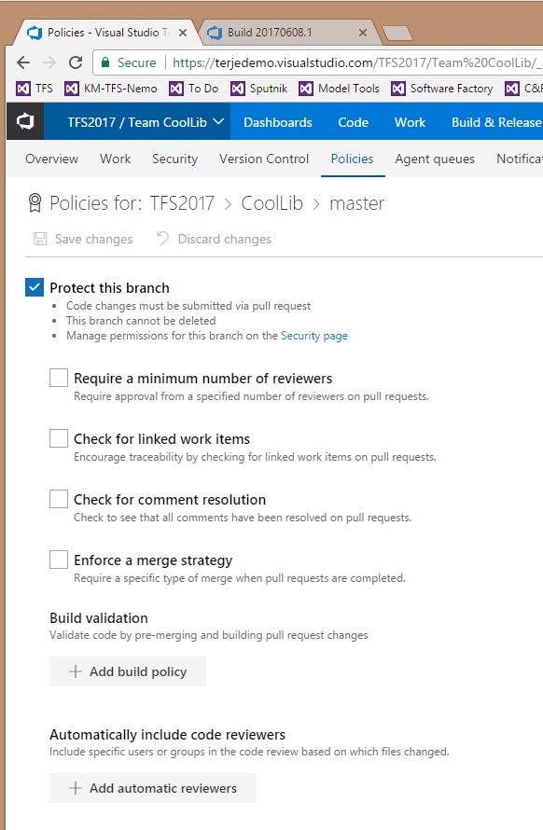
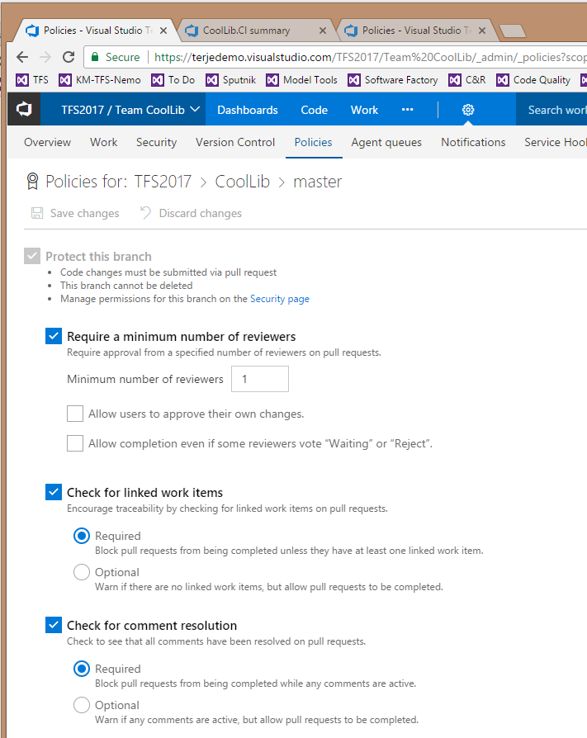
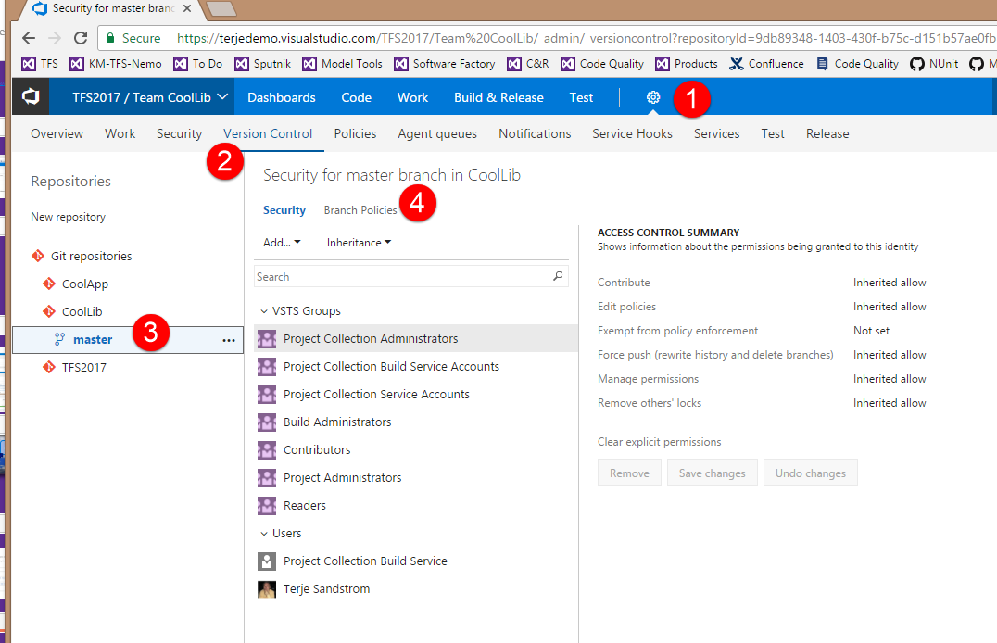
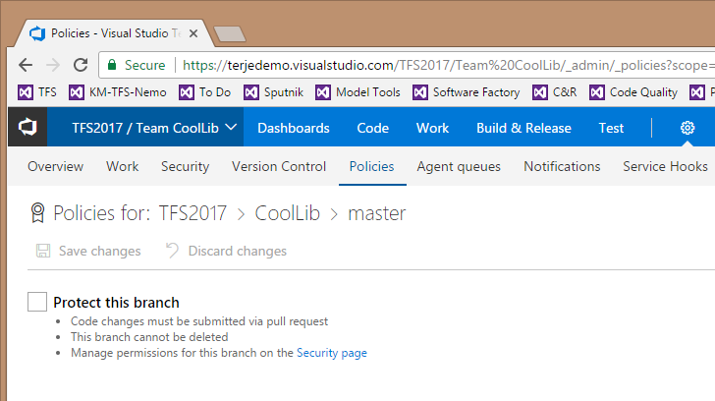
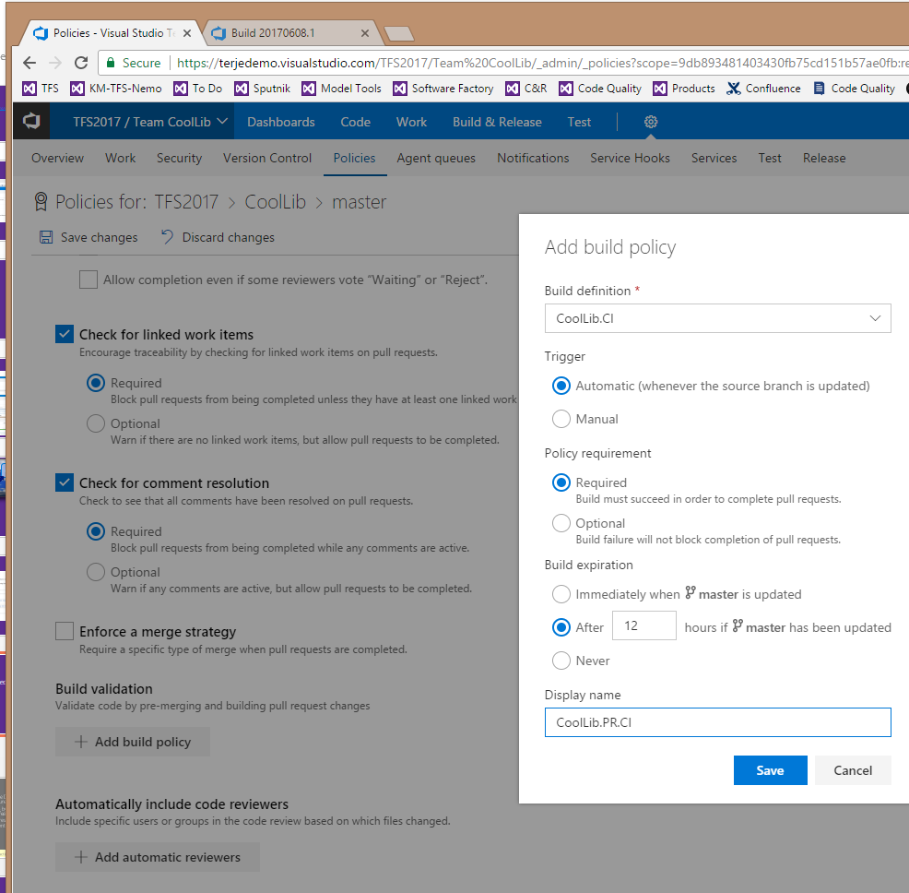
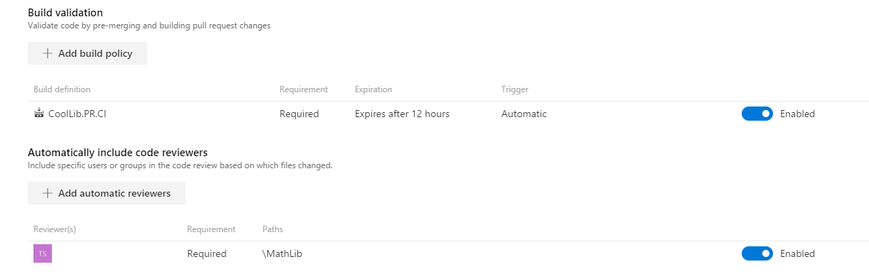
Setting up a PR policy

Slide 7
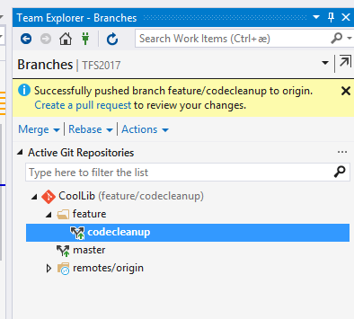
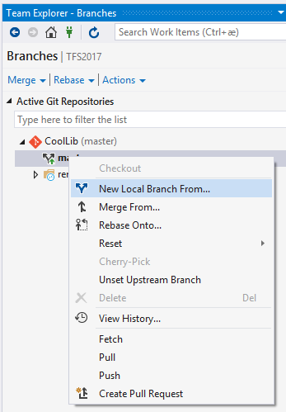
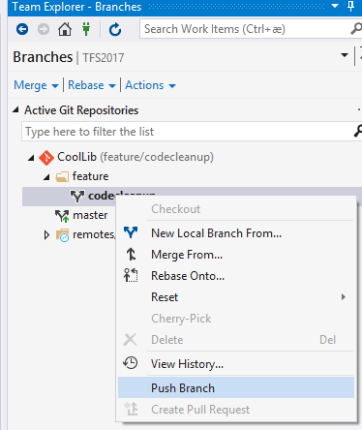
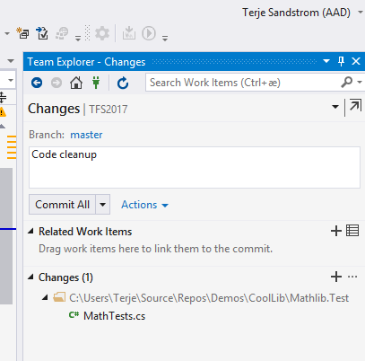
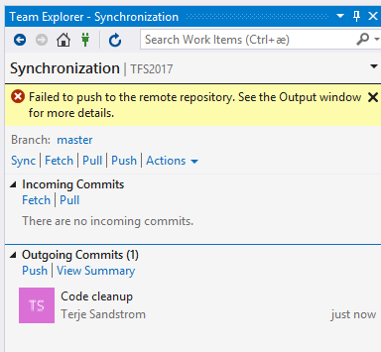
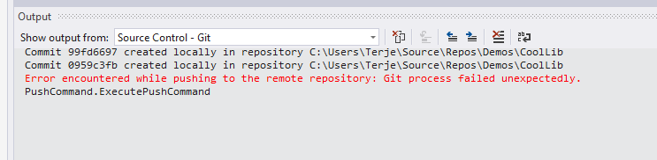
Doing a code change with a PR policy in effect

Slide 8
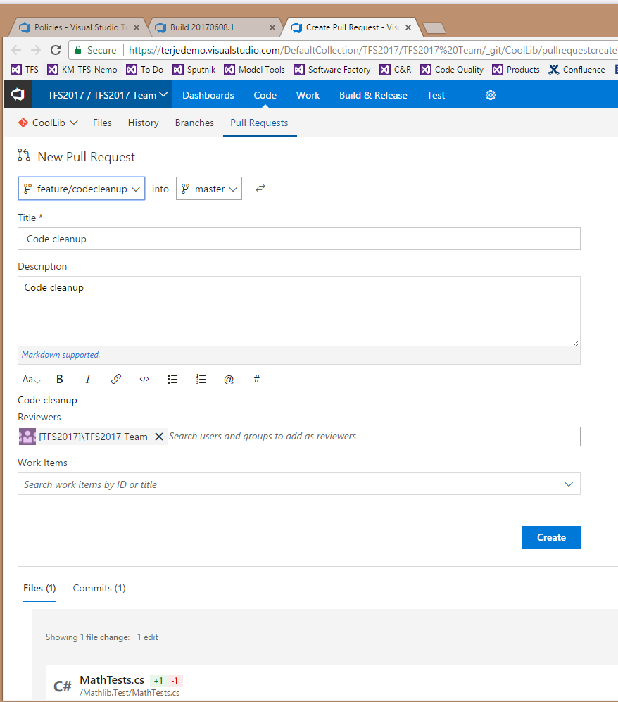
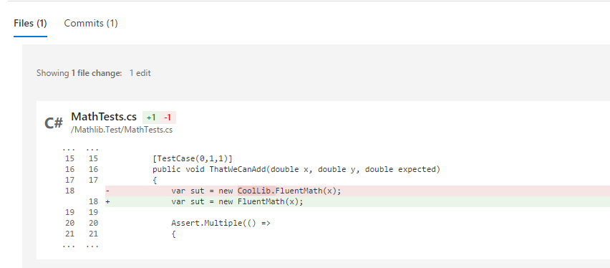
Doing a code change with a PR policy in effect

Slide 9
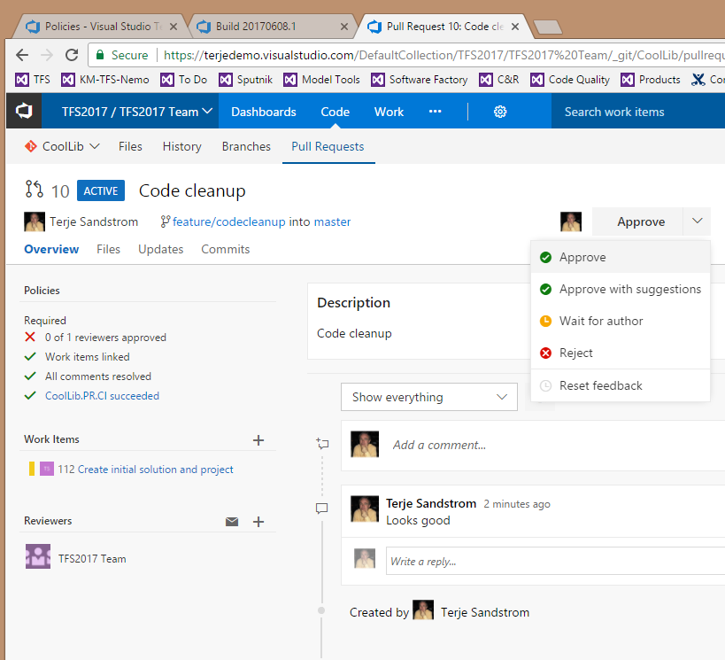
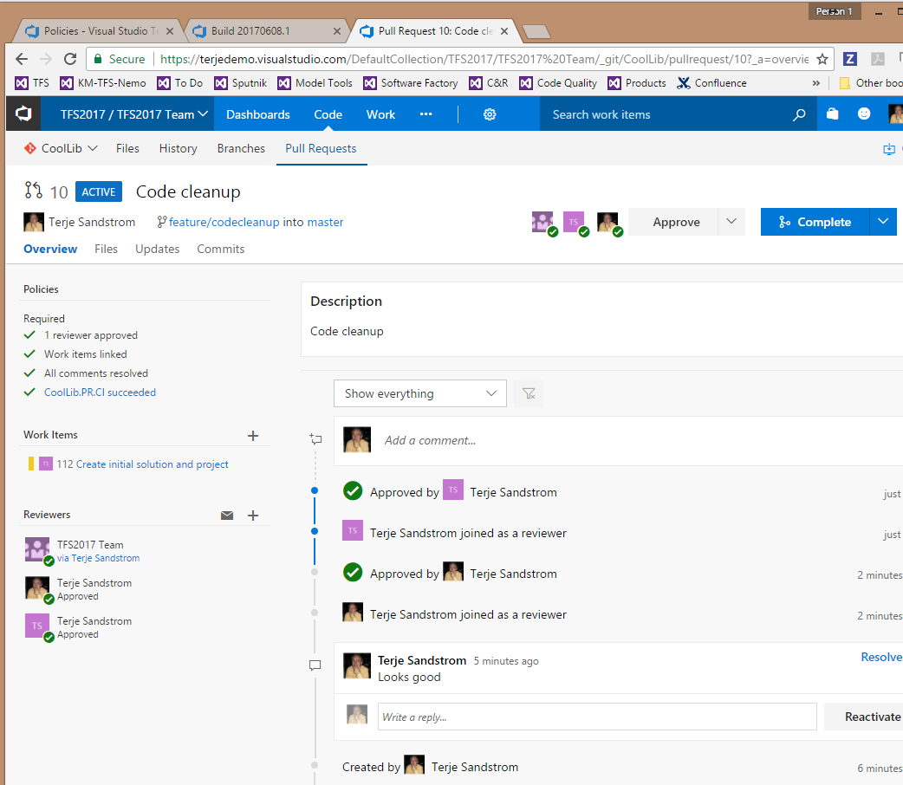
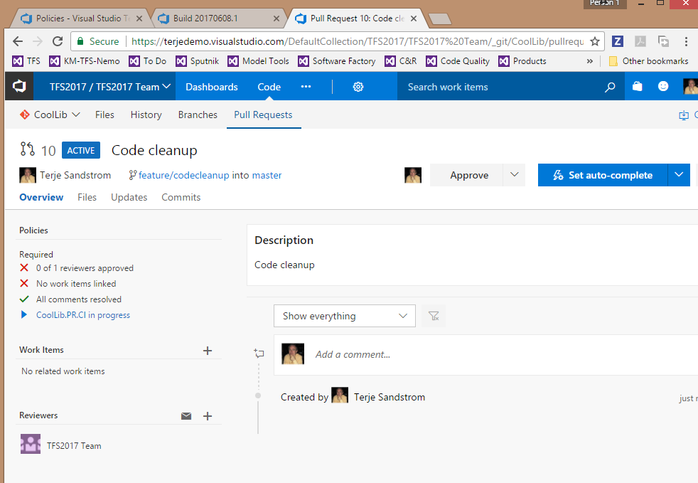
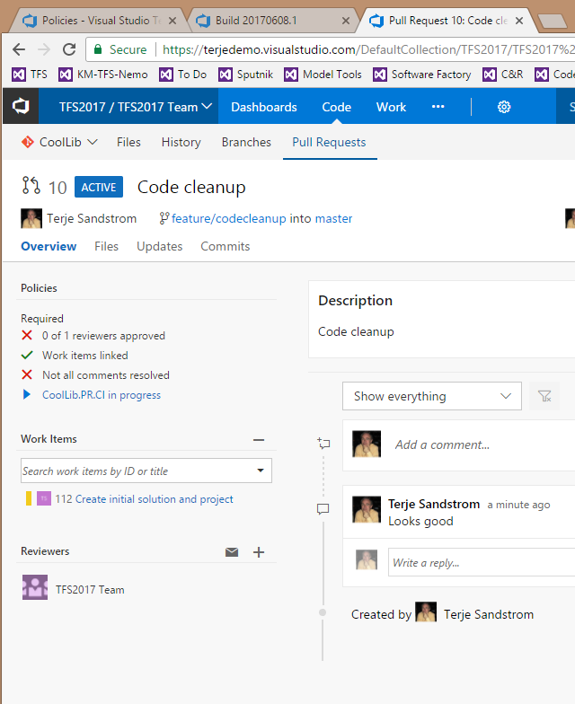
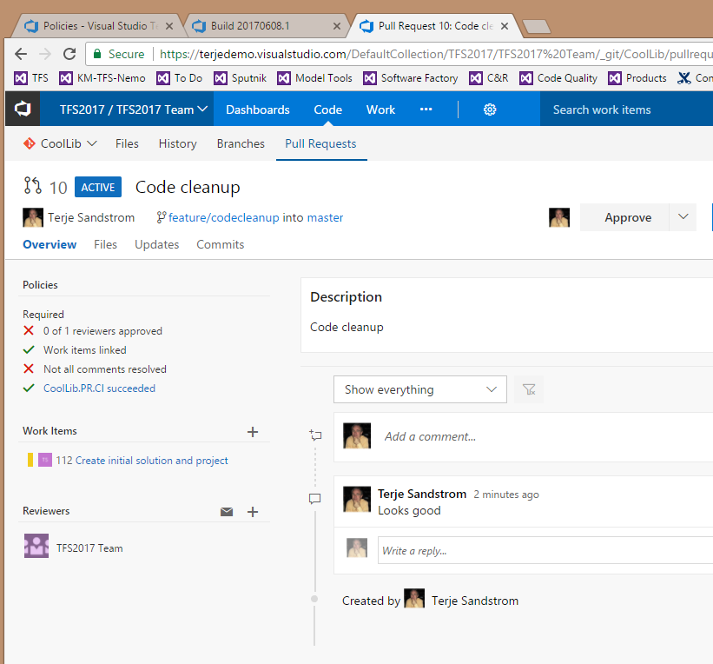
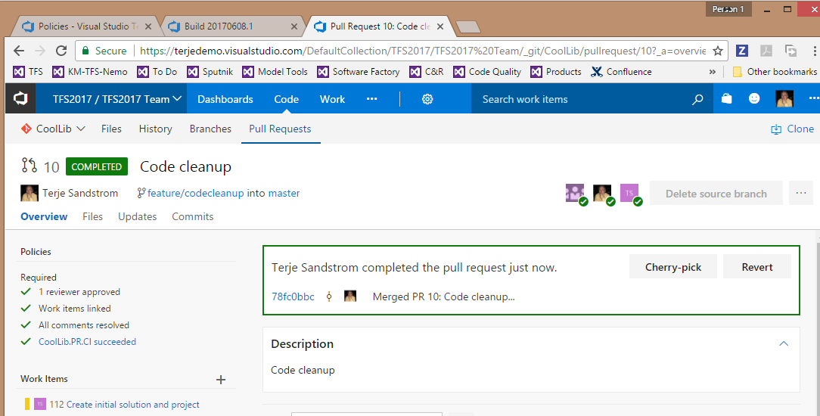
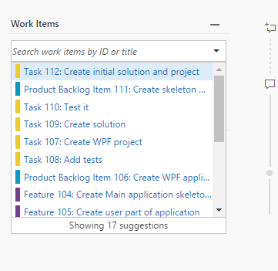
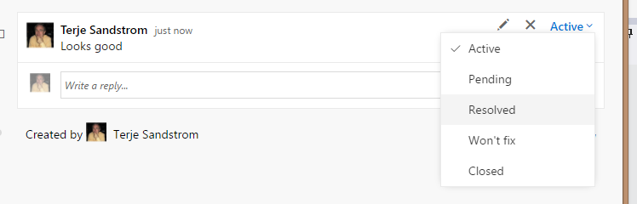
PR

Slide 10
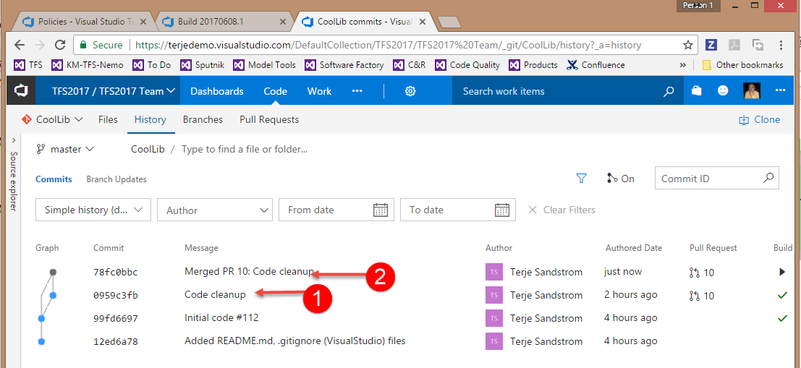
What happened in source

Slide 11
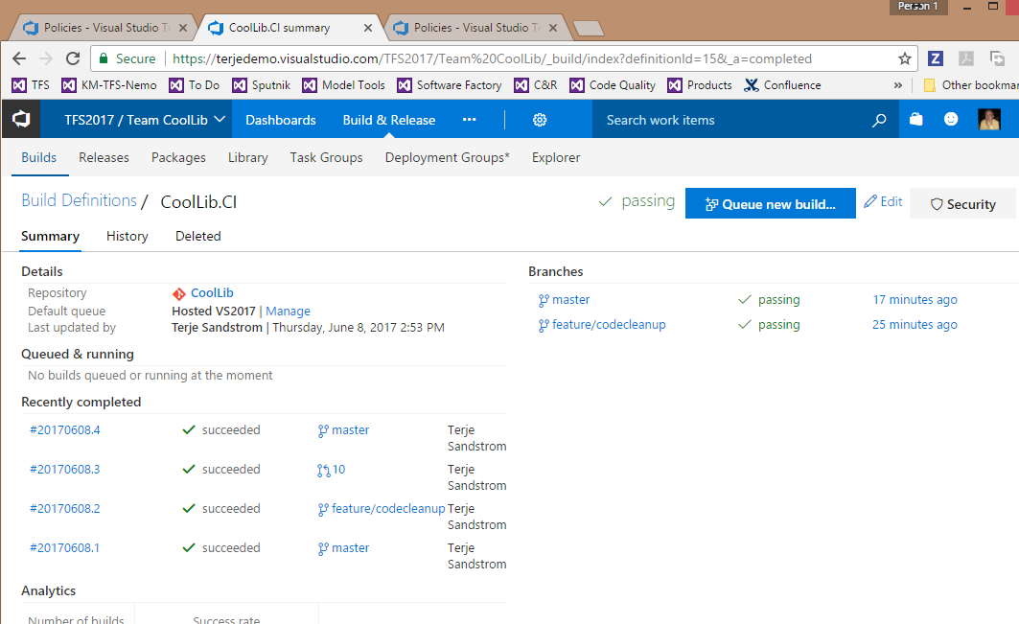
What happened in build

Slide 12

$$e^{x}=1+\frac{x}{1!}+\frac{x^{2}}{2!}+\frac{x^{3}}{3!}+…, −∞<x<∞$$

Slide 13
Build

Slide 14
Build architecture (on-premises/Classic)
TFS server
Build controller
Build Server 1
Build Server 2
Build controller
Build Server 3
Build agent 1
Build agent 2
Build agent 1
Build agent t
Buidl agent 1

Slide 15
Build architecture (2017)
Concurrent pipeline : Queue system between TFS server and build agent
VSTS
https://www.visualstudio.com/en-us/docs/build/concepts/licensing/concurrent-pipelines-ts
(#Build Pipelines = 1+ NoOfMSDNUsers (MSDN Enterprise Licensed users)
TFS
https://www.visualstudio.com/en-us/docs/build/concepts/licensing/concurrent-pipelines-tfs
(#Relase Pipelines = 1+ NoOfMSDNUsers (MSDN Enterprise Licensed users)
(#Build Pipelines = Unlimited
Hybrid: VSTS with private builds: VSTS build pipelines used

Slide 16
Typical types of builds
CI
Builds for every push, for all branches
Release
Builds scheduled, for release builds
Publish
Builds nuget packages for consumption by other libs or apps
Integration/Functional Test
Builds running automated tests, long running
QA
Builds for specific long running code quality, connect to SonarQube or custom
Deploy
Builds to only deploy to [staging] environments
Run
Builds that runs executables to perform jobs

Slide 17
CI build characteristics
Should run in less than 10 minutes
Using git repos, build times in seconds or a few minutes are achievable
Contains compile and unit tests
Use only REAL unit tests, filter out component, integration or any other long running test using test categories

Slide 18
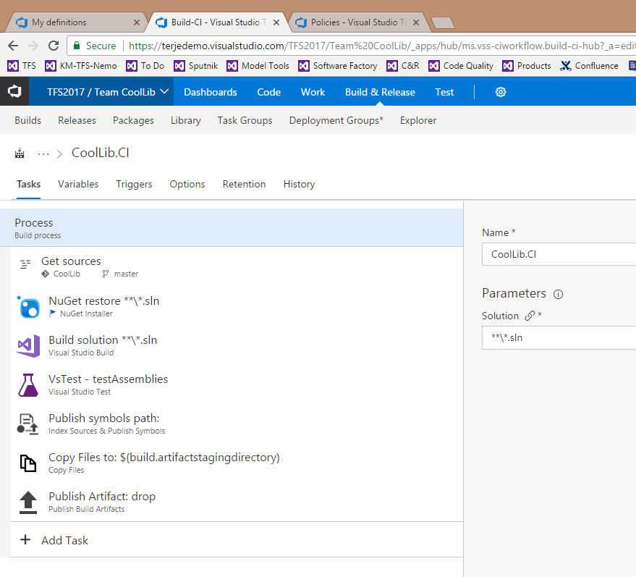
Build definition

Slide 19
Build demo

Slide 20
Test demo

Slide 21
Packages
Splitting a system into composable blocks
Stable sub systems with well defined interfaces and a clear dependency chain
Typically start with leaf nodes in the system tree
Move code into a git repository, publish as a nuget package
One repo can publish one or more nuget packages

Slide 22
Package content
Prefer to make packages Release, AnyCPU
For native packages, use target files, consider splitting into dev packages and distribution packages. The former containing h- and lib-files in addition, and perhaps be debug.
Include pdb files
Possibly Include xml intellisense files.

Slide 23
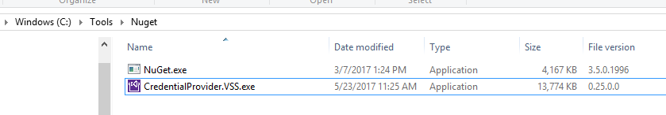
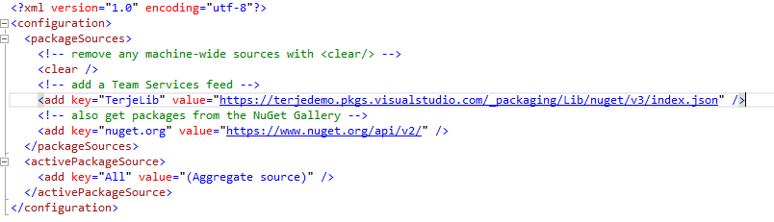
Setting up local package feeding to VSTS
See https://www.visualstudio.com/en-us/docs/package/nuget/nuget-exe
Download credential provider from: https://{account}.pkgs.visualstudio.com/_apis/public/nuget/client/CredentialProviderBundle.zip
Nuget config:

Slide 24


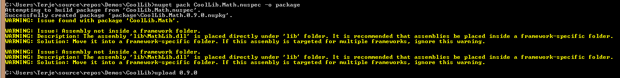
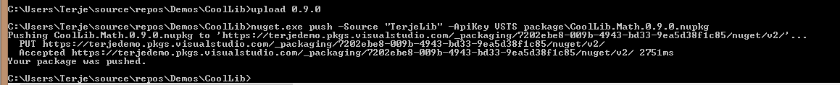
Pack and push (upload)

Slide 25
Tests : Demo
Unit tests
Code coverage: https://docs.microsoft.com/en-gb/visualstudio/test/analyzing-code-coverage-in-build-verification-tests

Slide 26
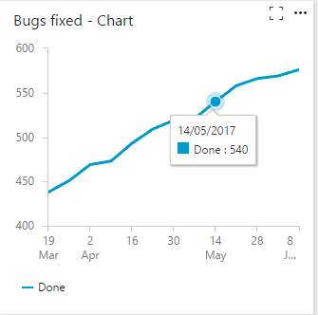
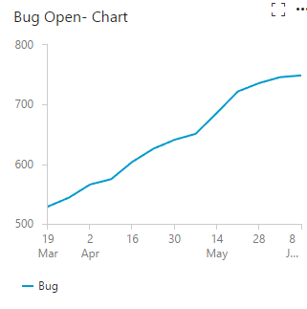
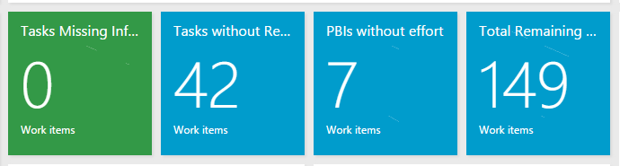
Dashboard examples

Slide 27
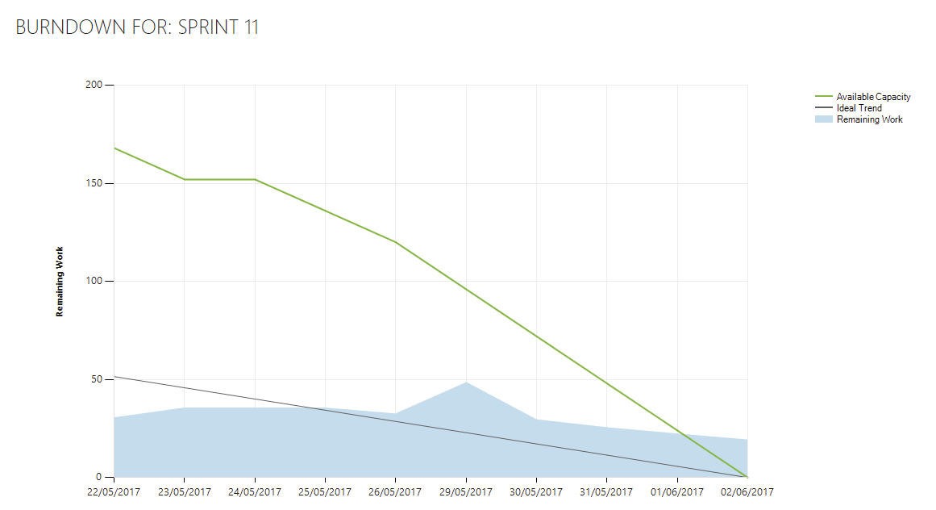

Slide 28
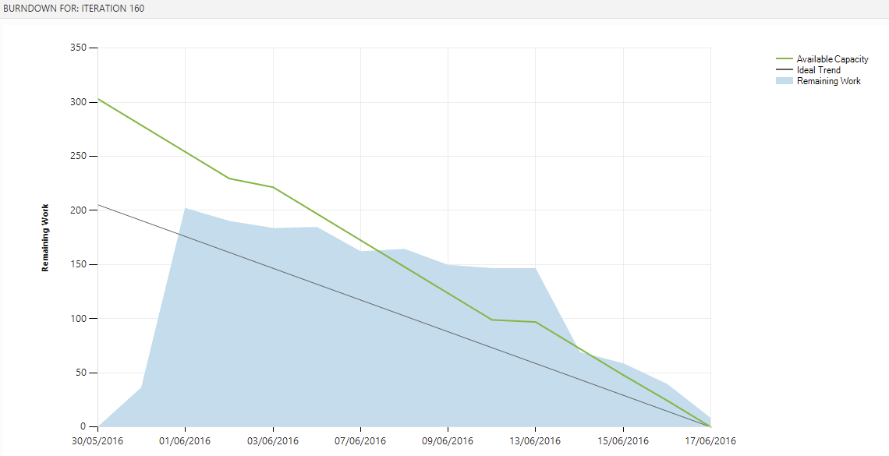

Slide 29
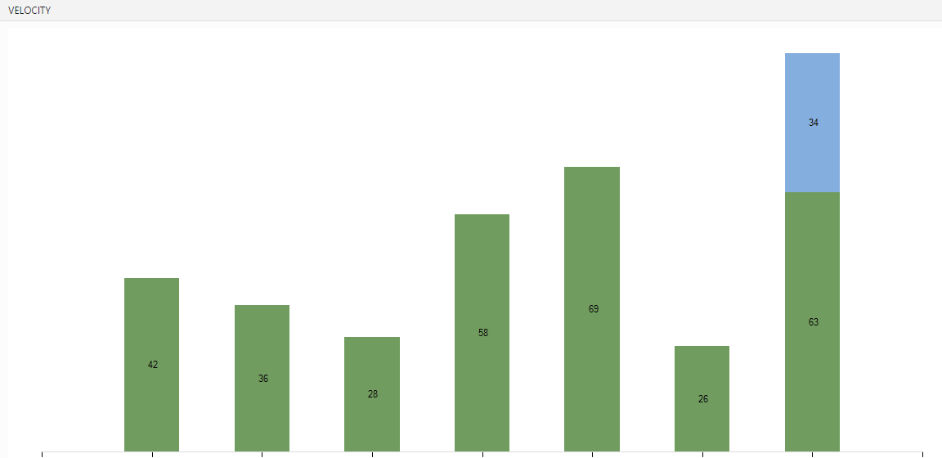

Slide 30

$$\cos{α}+\cos{β}=2\cos{\frac{1}{2}\left(α+β\right)}\cos{\frac{1}{2}\left(α−β\right)}$$

